Slide 1
Magic Of Micro-Controller
An Intensive Training Course on Micro-Controller
Brought To You By TechShopBD.Com

Slide 2
Topics
Basic Electronics
Digital Logics and Number Systems
Schematic Designing
Software Simulations
PCB Designing

Slide 3
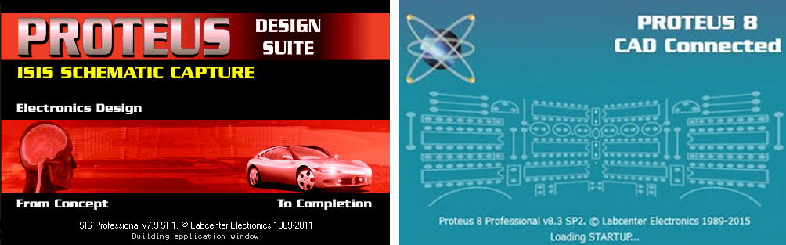
Schematic Design
Installing Proteus 7 (Schematic Designing)
Installing Proteus 8 (PCB Designing)

Slide 4
Software Download Link
Download Proteus 7
Link: https://drive.google.com/open?id=0Bwx1Cp892WAUd1M3VW9lTlVhRHc
Download Proteus 8
Link: https://drive.google.com/open?id=0Bwx1Cp892WAUNURJSWo1ZWcxT0U
Download Atmel Studio
Link: https://drive.google.com/open?id=0Bwx1Cp892WAUbkF1MXN6VUxLbEU
Download WinAVR
Link: https://drive.google.com/open?id=0Bwx1Cp892WAULVNUMERpT041REE
Download AVRDUDESS
Link: https://drive.google.com/open?id=0Bwx1Cp892WAUZFZGMHlTZUpZLVk
Download USBasp Driver
Link: https://drive.google.com/open?id=0Bwx1Cp892WAUUW1zTlRBV1NUWmM

Slide 5
Proteus Shortcuts
Open Design = Ctrl + O
Save Design = Ctrl + S
Quit ISIS = Q
Find / Edit Component = E
Undo Changes = Ctrl + Z
Redo Changes = Ctrl + Y
Align Objects = Ctrl + A
Toggle False Origin = O
Toggle X-Cursor = X
Toggle Grid = G
Set 10th grid snap = Ctrl + F1
Set 50th grid snap = F2
Center at cursor = F5
Zoom In = F6
Zoom Out = F7
Zoom to view enter sheet = F8
Net list & Transfer to ARES = Alt + A
Run Simulation = Alt + F12
Stop Simulation = Esc(2)
Pick parts from libraries = P

Slide 6
Proteus Shortcuts
Rotate Clockwise = R (Assign first)
X-Mirror = Ctrl + M
Y-Mirror = Mouse right click >> Y-Mirror
Delete parts = Mouse right button 2X click
Copy parts = Mouse right click >> Copy to Clipboard
Cut parts = Mouse right click >> Cut to Clipboard
Paste parts = Mouse right click >> Copy to Clipboard
PCB Foot Print = Mouse right click >> Packaging Tool
Edit Properties = Mouse 2X click on Parts or [Ctrl + E]
Zoom To Area = Click on Zoom To Area Icon

Slide 7
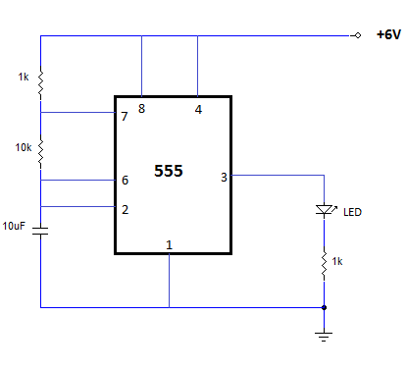
Circuit Diagram
TH = 0.693*(RA+RB)*C
TL = 0.693*RB*C
D = Duty Cycle = (RA+RB) / (RA+2*RB)

Slide 8

PCB Design
Printed circuit boards are physical components of electronic devices. They're made up of a board, which is typically resin or plastic, and solder, the conductive metal parts that channel energy, usually made of copper.

Slide 9
PCB Design
Start by drawing your schematic diagram.
You need to transfer your schematic diagram into a PCB Layout.
Send the PCB Layout your PCB manufacturer.
Or make a PDF file of Top Silk, Bottom Silk, Top Copper, Bottom Copper, Top Masking, Bottom Masking and finally submit it.
Link: https://www.youtube.com/watch?v=Xvncw1W0ZM0

Slide 10
PCB Layout Rules & Limits
For screen printing method, please follow the given rules and limit for you PCB.
Single Layer sizing:
25th pad to pad spacing minimum
25th trace to trace spacing minimum
30th drill size minimum
30th drill mark minimum
Double Layer sizing:
All the above rules applicable
Via must be 70th pad with 30th drill hole minimum

Slide 11
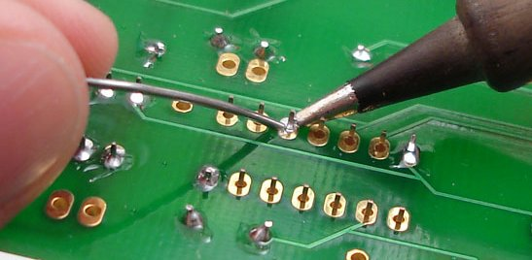
Soldering
Always try to maintain 45 degree angle between PCB Board and Soldering Iron Lead.

Slide 12
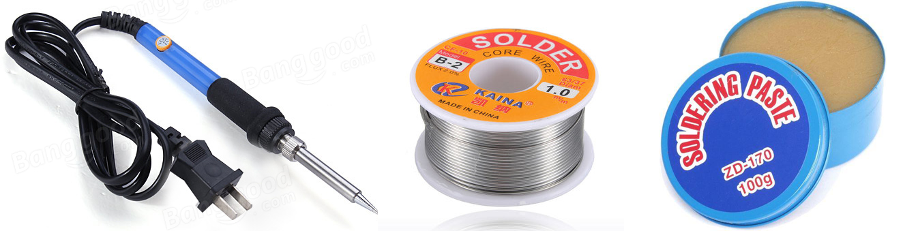
Soldering
Soldering Iron (40W)
Soldering Lead
Soldering Paste

Slide 13
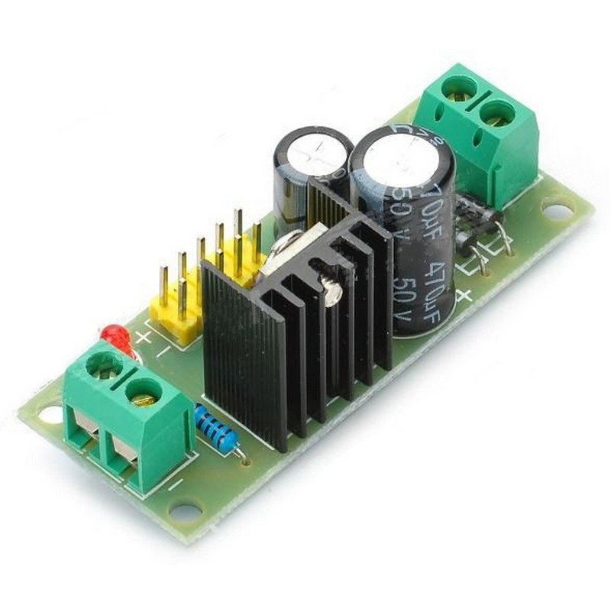
Home Task
Schematic & PCB design of a constant +5V DC power supply.
Tutorial Link: https://www.youtube.com/watch?v=azc_CYP0hAw&list=PLRhEWhnblSonuQCL4ORvY8_1BbsNb_rKq&index=2
Project Videos: https://www.youtube.com/watch?v=Rhzbz5F7-ao

Slide 14


Slide 15
Thank You

